Slide 1
Downspout erosion
By:Arianna,Abel,Zair,Brenda,Betty,Karli,ricky,

Slide 2
The problem.
It is located next to the rose bushes near the seventh grade pod
Staff, students, administrators ,and guests
No one is impacted by the problem but it could cause problems in the near future

Slide 3
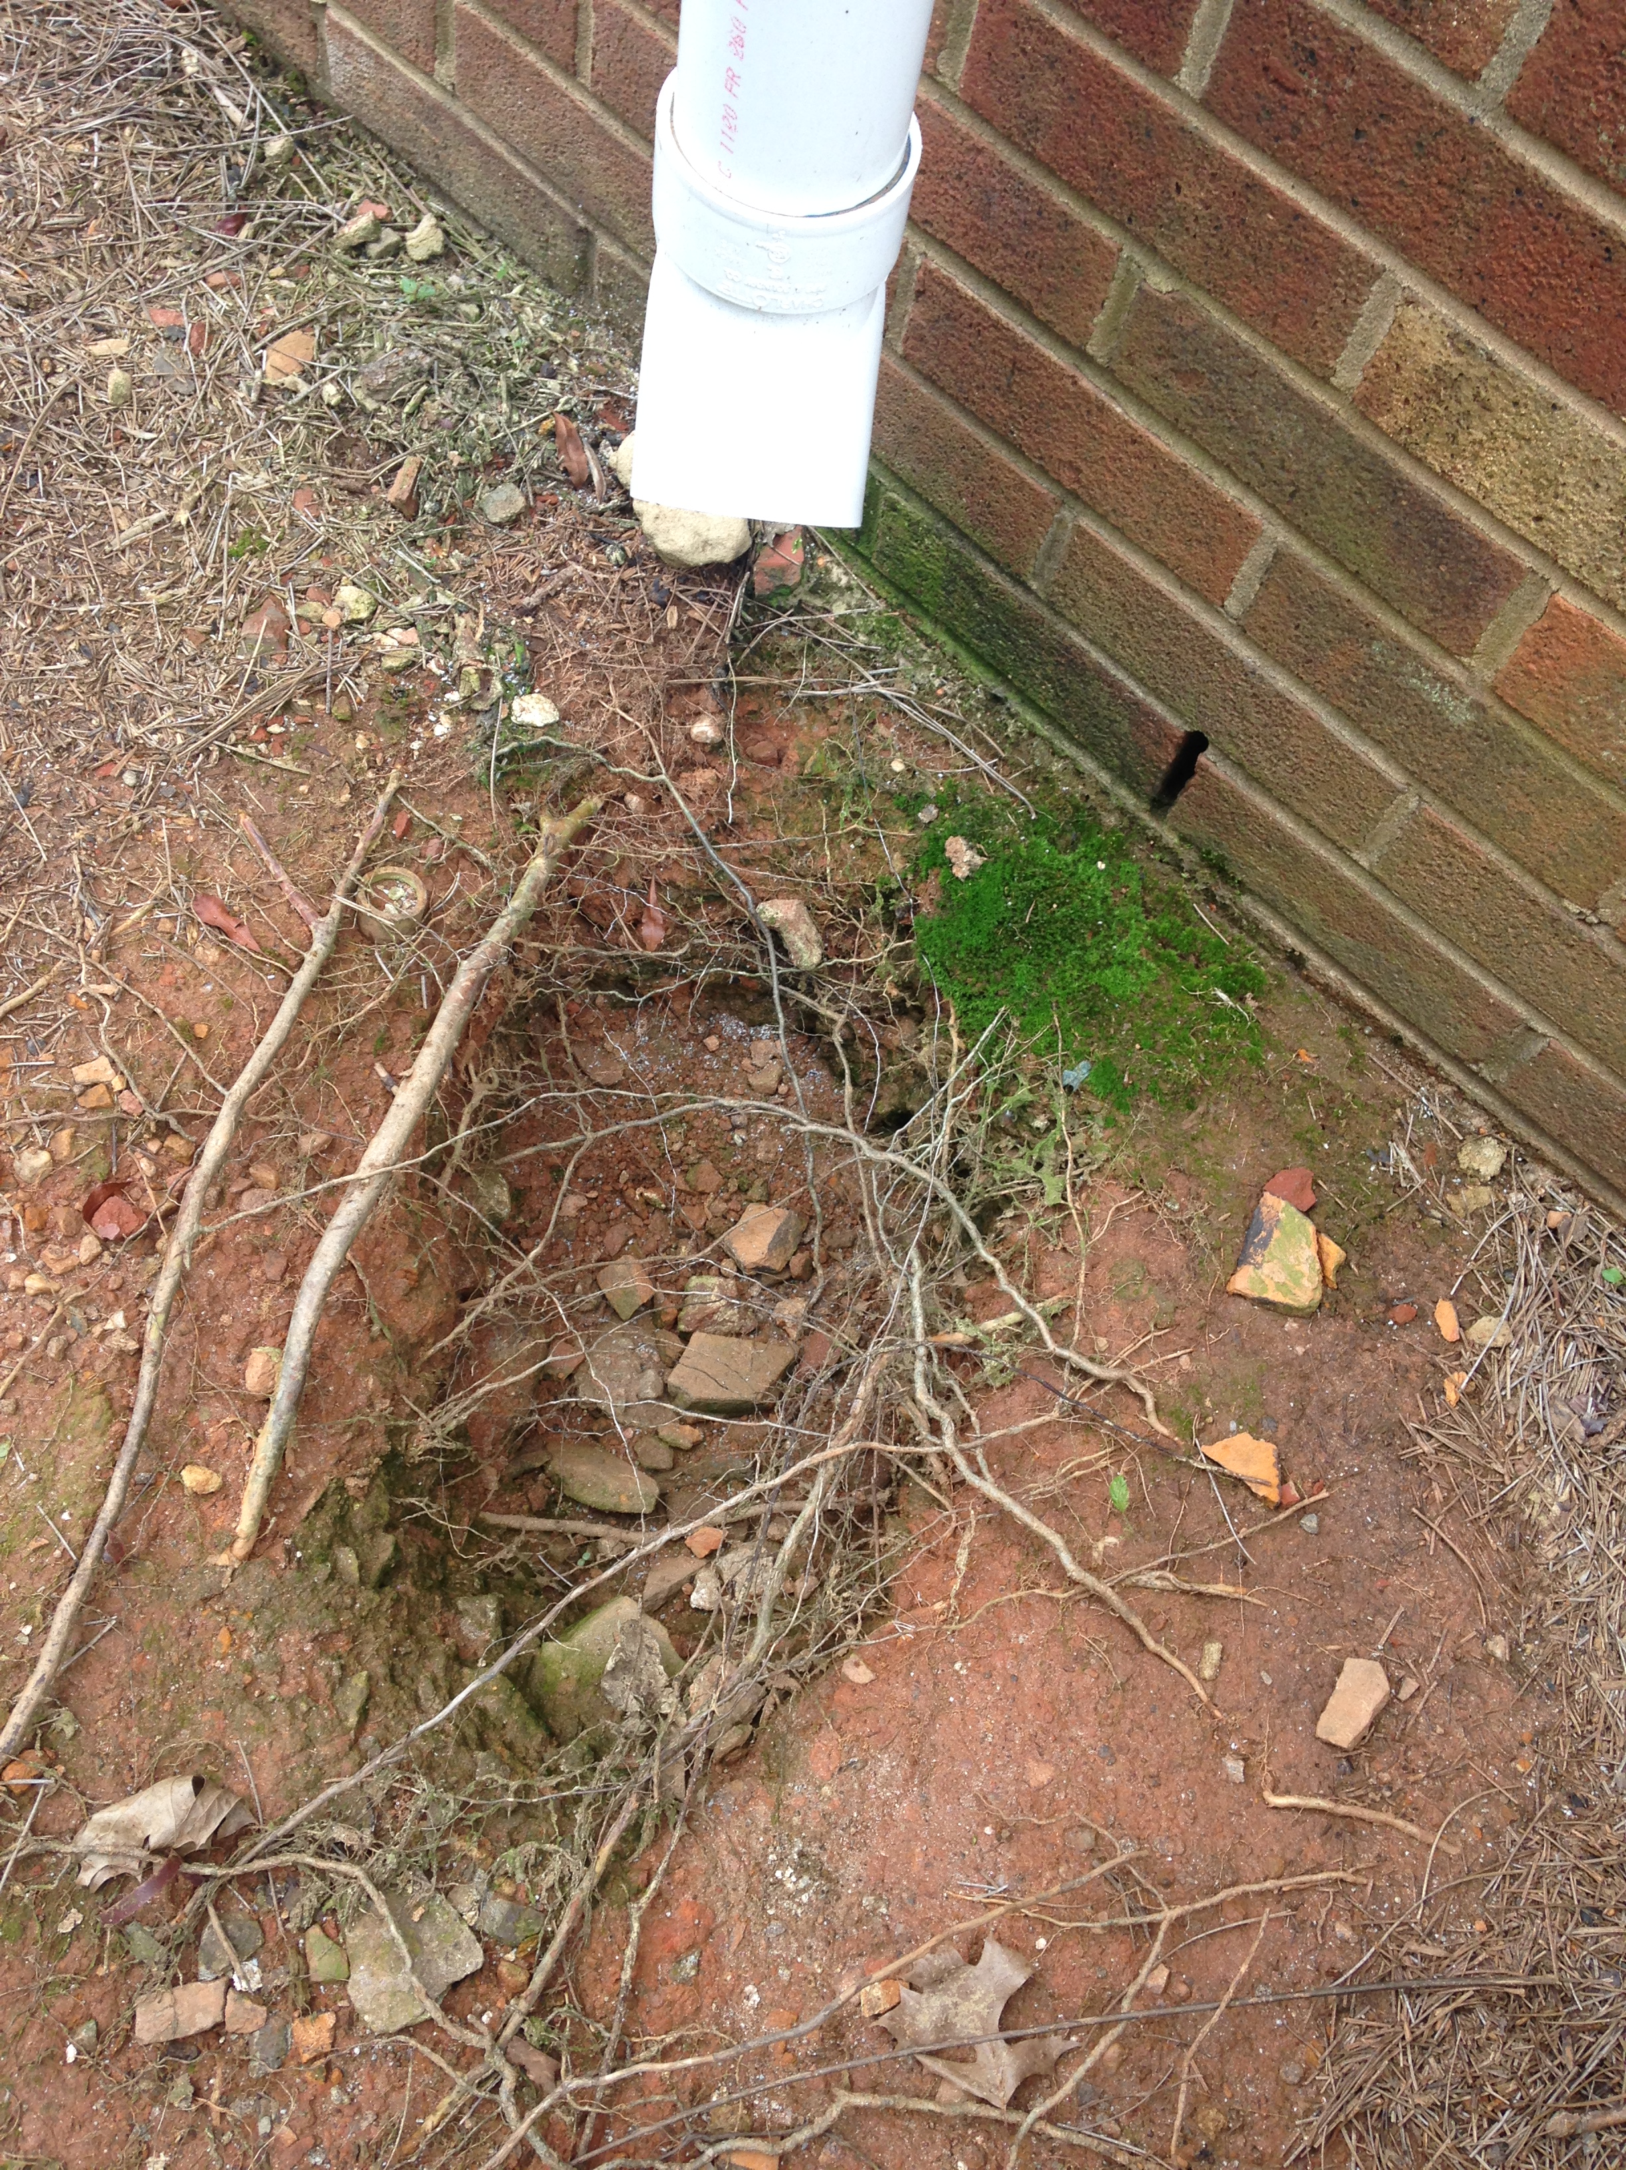
Why do you consider is an issue?
The problem is aesthetic, because it is not great to look at and effects the way people see our school
It doesn't affect how anything works so it is functional.

Slide 4
How we think we can fix the problem
We think we can fix this problem filling the hole with rocks and taking pipe connecting it to the spout. We could direct the pipes to the drain so no damage is done.
Our materials needed are the rainforest rocks and moving water pipes x4
The anticipated price would be 58$
It is quite a small issue but all of the little things matter when trying to make a good impression
I believe that the process would take about a day
Fixing this problem would affect the areas around positively by reducing erosion

Slide 5
thank you for taking the time to listen to our presentation!

